Slide 1

Replicating Stock Closing Price Prediction using Machine Learning Techniques
By Andrew Kaminer, Tia Kungwani, and Siddharth Vijay

Slide 2
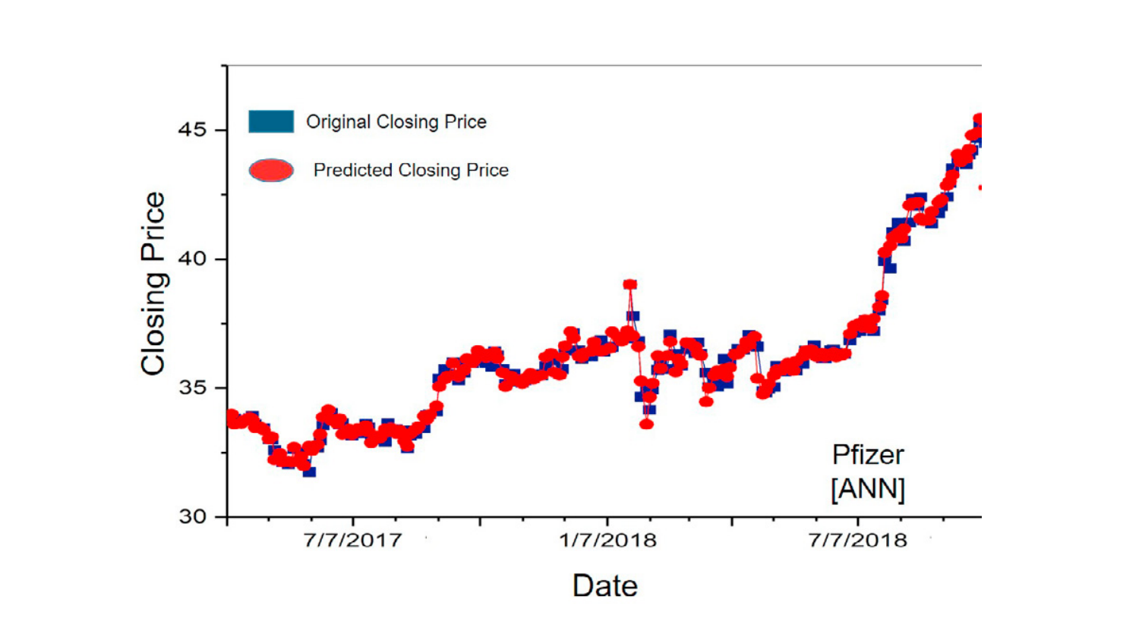
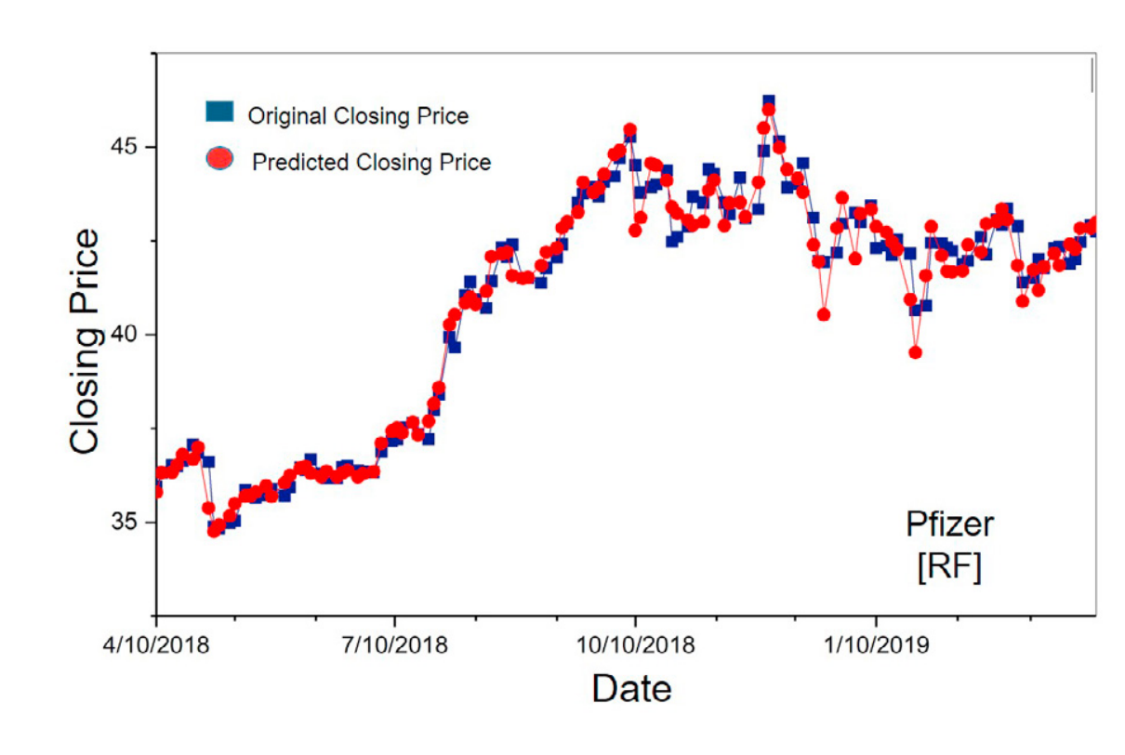
Basics About Study
Used to predict closing price of 5 stocks: Nike, Goldman Sachs, Johnson and Johnson, Pfizer and JP Morgan Chase and Co.
Uses 2 ML Models:
Artificial Neural Network
Random Forest Model
Trained Data Set from 2009 - 2017
Tested Data from 2017 - 2019
Vijh, Mehar et. al
ANN Model
RFM
Model
Notes:
Andrew

Slide 3
How it relates to Initial Interests
Initial Interests:
Model that could be adopted in today’s market ✅
Develop tool that can be used by traders to make decisions ✅
Use historical data to predict future prices ✅
Use Regression Model ✅
Notes:
Andrew

Slide 4
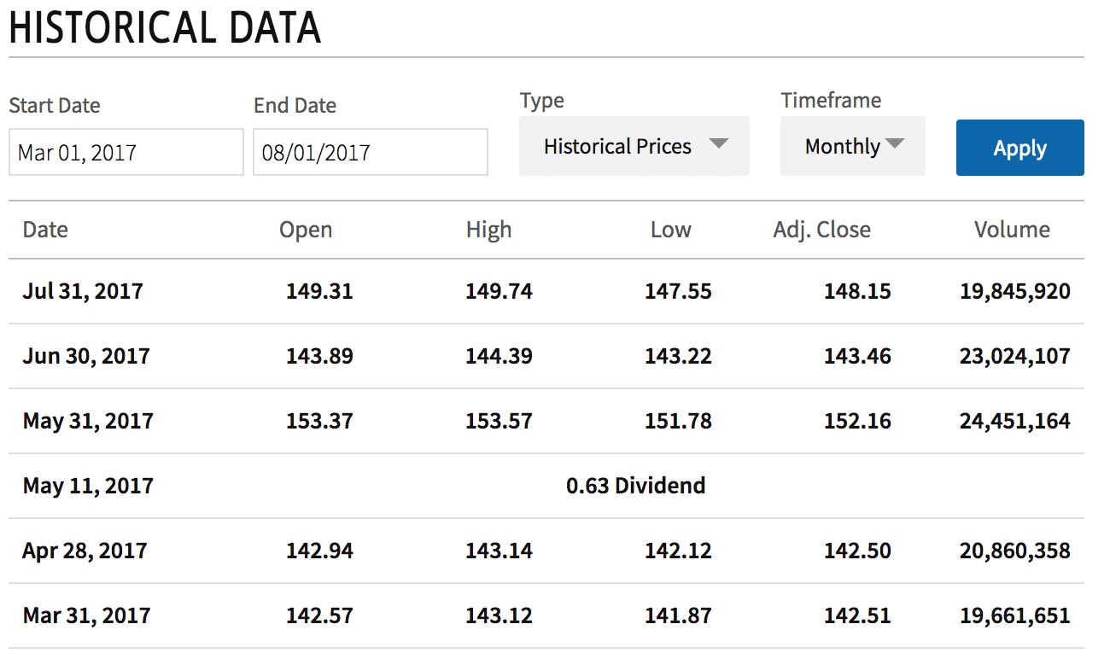
Acquiring the Data
XBRL
Yahoo Finance
SEC EDGAR
Bloomberg Terminal
Investopedia
Notes:
Tia

Slide 5
Model(s)/Statistical Techniques
Neural Network (Artificial Neural Network)
3 layers of nodes
Identifies and generalizes trend in data
Random Forest
Many decision trees
Decides through a “vote” which decision is correct
New Parameters
Extend the parameters to include more intrinsic data
Notes:
Andrew

Slide 6
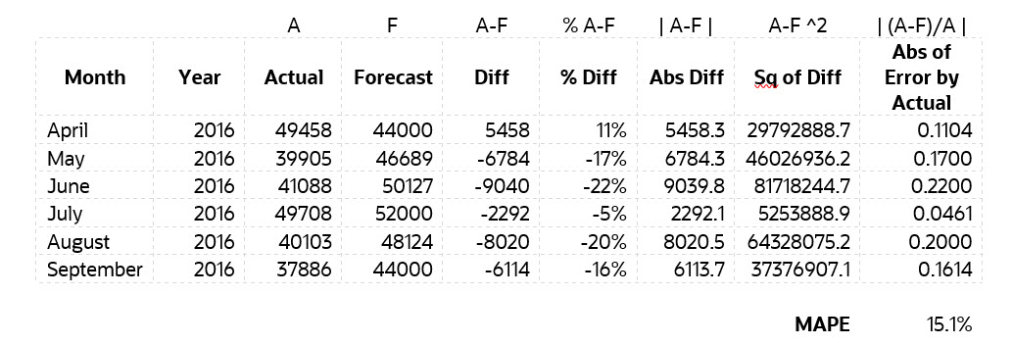
Anticipated Results
We anticipate that the ANN model will prove to be a better estimation technique
Likely to give lower root mean square error (RMSE) value
Likely to give lower mean absolute percentage error (MAPE) value
Notes:
Tia: We anticipate that the ANN model will prove to be a better estimation technique as it is likely to give lower root mean square error (RMSE) and mean absolute percentage error (MAPE) values, indicating that the ANN model is more accurate and efficient in predicting stock closing price.

Slide 7
Individual Roles: Sid
Extracting Data
Computing Initial Descriptive Statistics and analyzing differences between ANN and RFM
Assist with developing ANN and RFM models
Notes:
Andrew

Slide 8
Individual Roles: Tia
Gaining a conceptual idea of how to develop the models
Work on developing the neural network
Tuning the models

Slide 9
Individual Roles: Andrew
Understanding the results of the study and trying to match them
Working on the random forest
Plotting

Slide 10
6 Week Plan
Week 10:
Tia: Get a conceptual idea of how to make the models
Sid: Collect data
Andrew: Look at study results and figure out how to compare our results from the study’s
Week 11:
Tia: Start work on neural network
Sid: Clean the data + Descriptive statistics
Andrew: Start work on random forest
Week 12:
Tia: Continue working on neural network
Sid: Jump on to whichever model needs the most work
Andrew: Continue working on random forest
Week 13:
Everyone: first attempts at replicating paper results and plotting
Week 14:
Tia: Tune models
Sid: Tune models
Andrew: Improve plotting and making sure we replicate the main results of the paper
Week 15:
Tia: Slideshow
Sid: Report
Andrew: Report
Notes:
Andrew

Slide 11
Literature Review
Link to document with Articles
Notes:
Tia

Slide 12
Literature Review
Most used journals:
The Journal of Finance
The Journal of Financial Economics
The Journal of Risk and Finance Management
Common topics:
Outperforming the market
Extending traditional pricing models like Black Scholes’ and the CAPM
Machine learning for predicting the market (going beyond traditional regression techniques)
Identifying the most important factors in pricing a company
Notes:
Tia

